Slide 1

STARTUP meeting for High School Maths Teachers at the start of 2026
brought to you by the
Notes:
Introduce myself
Pleased to have the opportunity to share some wisdom and experience
Everything works some of the time, nothing works all of the time
Part philosophical and part practical
RECORDING IT and we will share the slideshow too
Q and A at the end….

Slide 2
Some general thoughts…
Important work!
Notes:
Work of consequence – it MATTERS!
Equipping our youth for the future
The best way to find yourself is to lose yourself in the service of others! (GANDHI)
Building site….

Slide 3
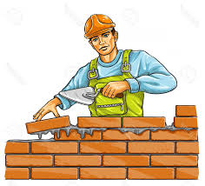
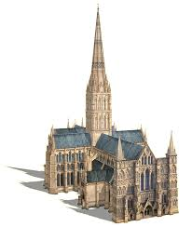
Are you just laying bricks
or
are you building a Cathedral?

Slide 4
Some general thoughts…
Important work!
A new year – a clean slate
Your presence is your present
HIGH energy
HIGH expectations
Notes:
REALLY present – on your feet – not on your phone!
I know teachers who have taught for more than 30 years …..
Absenteeism…… ☹
PASSION
Cannot expect our learners to get taken with Trig, crave calculus or love logarithms if we are not excited each day!

Slide 5

It’s all about relationships
Time
Trust
Vulnerability

Slide 6

CARE deeply
They don’t care how much you know until they know how much you care!

Slide 7

Use positive psychology!
Shawn Achor Clip
Notes:
People are more effective when they are happy
Self fulfilling prophesy
Watch the clip! (27M views)

Slide 8

Make your classroom a place of belonging – a safe place for all
Notes:
Maths anxiety IS a thing!

Slide 9


Criticize the behaviour not the person
You are dumb!
That was a dumb thing to do!

Slide 10
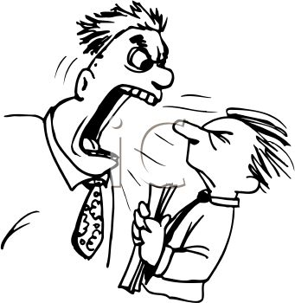
Never lose your temper!

Slide 11
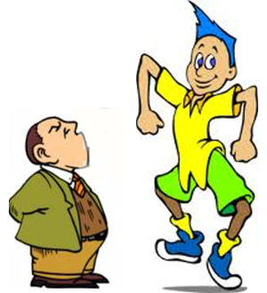
Don’t confront a showman in public

Slide 12

The golden guideline
What if this was my child?

Slide 13
Some big ideas in teaching Maths
Maths MAKES SENSE!
  It was not handed down to us on stone tablets like the commandments
Help your students learn their tables and bonds – the vocabulary of the language of mathematics. 7 x 9 = 63 is a fact!
Notes:
Izibalo zicaceka injalo!

Slide 14
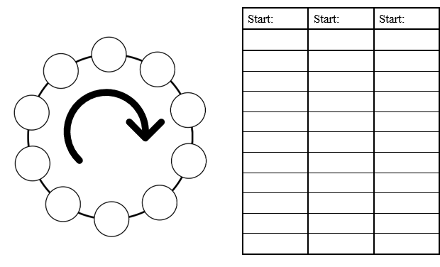
Notes:
Shell sheet - IAN

Slide 15
Some big ideas in teaching Maths
Maths MAKES SENSE!
  It was not handed down to us on stone tablets like the commandments
Help your students learn their tables and bonds – the vocabulary of the language of mathematics. 7 x 9 = 63 is a fact!
Maths is a great vehicle for teaching thinking

Slide 16

In today’s information rich and AI equipped world
the ability to THINK has never been more important!

Slide 17
Some big ideas in teaching Maths
Maths MAKES SENSE!
  It was not handed down to us on stone tablets like the commandments
Help your students learn their tables and bonds – the vocabulary of the language of mathematics. 7 x 9 = 63 is a fact!
Maths is a great vehicle for teaching thinking
Let your learners succeed early and succeed often

Slide 18
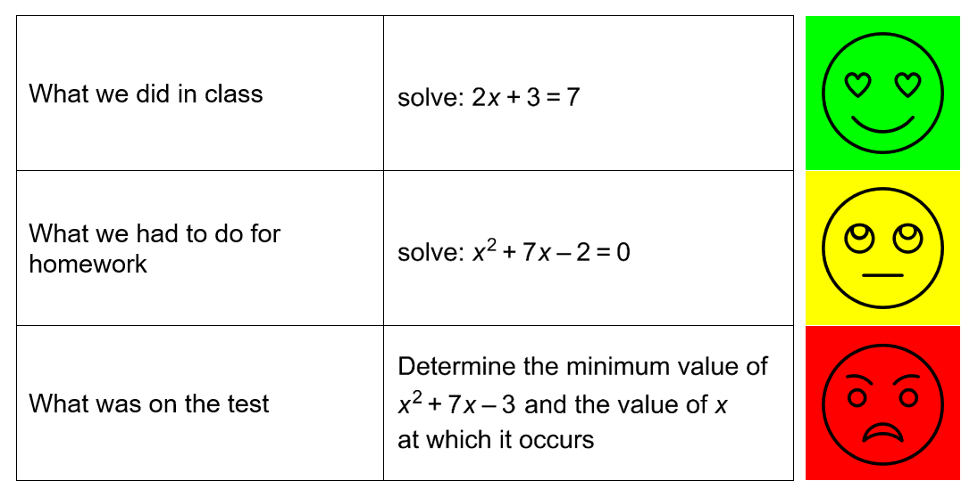
Notes:
Don’t set them up for failure.
Teaching has nothing to do with the love of power and everything to do with the power of love
Child abuse!

Slide 19
Some big ideas in teaching Maths
Maths MAKES SENSE!
  It was not handed down to us on stone tablets like the commandments
Help your students learn their tables and bonds – the vocabulary of the language of mathematics. 7 x 9 = 63 is a fact!
Maths is a great vehicle for teaching thinking
Let your learners succeed early and succeed often
We don’t do Maths because it’s easy. We do it to grow ourselves

Slide 20
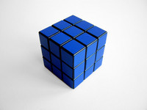
Just how easy do you want it?
Notes:
Maths demands and develops discipline, rigour and attention to detail – all valuable life skills

Slide 21
Some big ideas in teaching Maths
Maths MAKES SENSE!
  It was not handed down to us on stone tablets like the commandments
Help your students learn their tables and bonds – the vocabulary of the language of mathematics. 7 x 9 = 63 is a fact!
Maths is a great vehicle for teaching thinking
Let your learners succeed early and succeed often
We don’t do Maths because it’s easy. We do it to grow ourselves
Avoid a “colour by numbers approach” (teaching recipes without understanding).

Slide 22
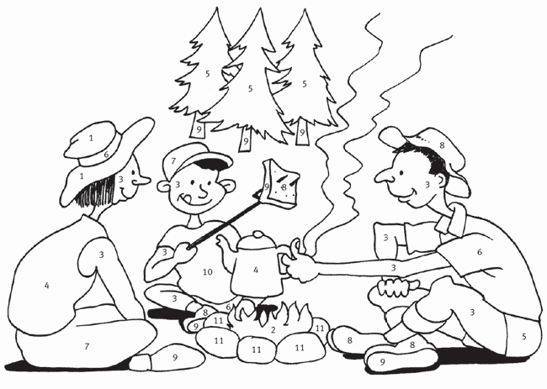
Notes:
While it may work in the short term – it’s unsustainable…..

Slide 23
Some big ideas in teaching Maths
Maths MAKES SENSE!
  It was not handed down to us on stone tablets like the commandments
Help your students learn their tables and bonds – the vocabulary of the language of mathematics. 7 x 9 = 63 is a fact!
Maths is a great vehicle for teaching thinking
Let your learners succeed early and succeed often
We don’t do Maths because it’s easy. We do it to grow ourselves
Avoid a “colour by numbers approach” (teaching recipes without understanding).
One cannot teach a concept only give kids opportunities to engage with it and thereby develop his / her understanding thereof
Allow learners time and space to come up with the rules themselves
Notes:
Let’s look at a couple of examples…..

Slide 24
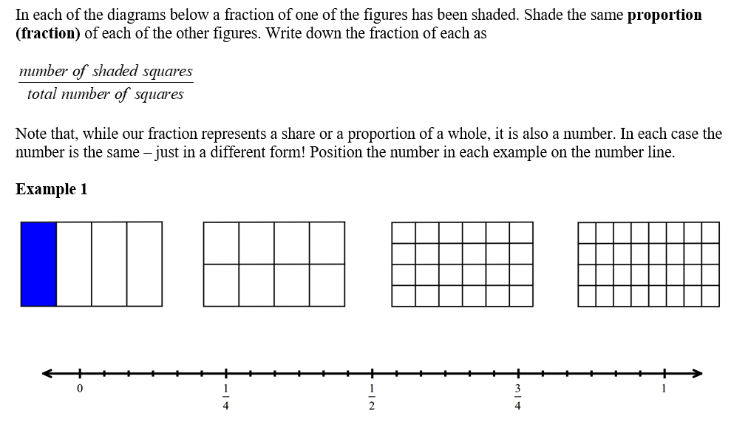








Notes:
Taken from a GRADE 8 SIMI workbook
Takes time – worth it!

Slide 25
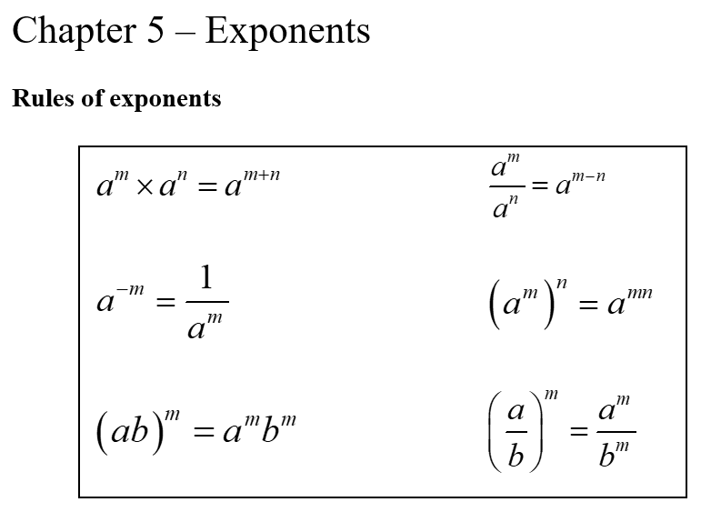
Notes:
Typical first page of an exponents chapter in a textbook

Slide 26
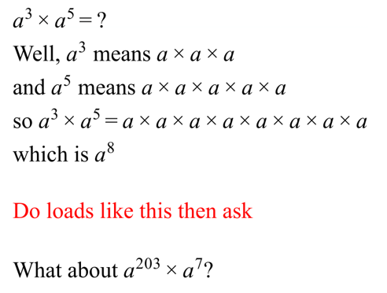

Slide 27
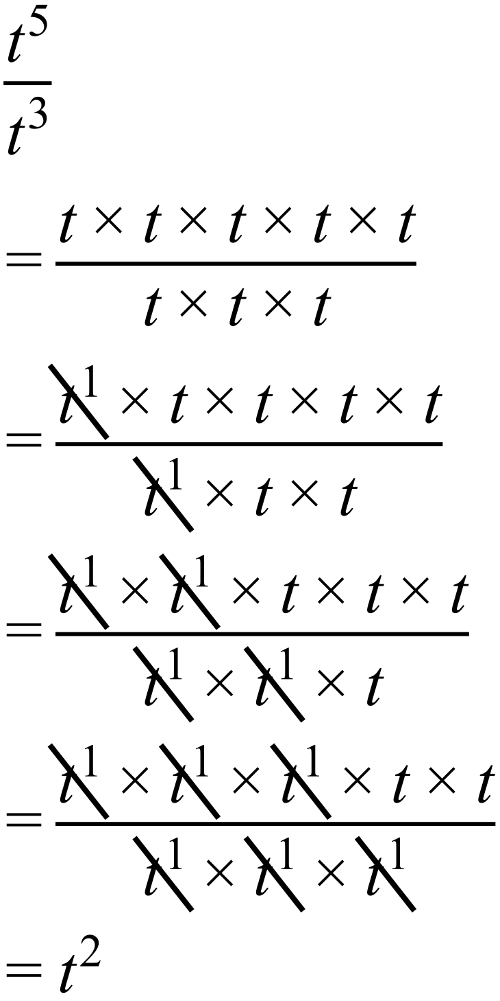
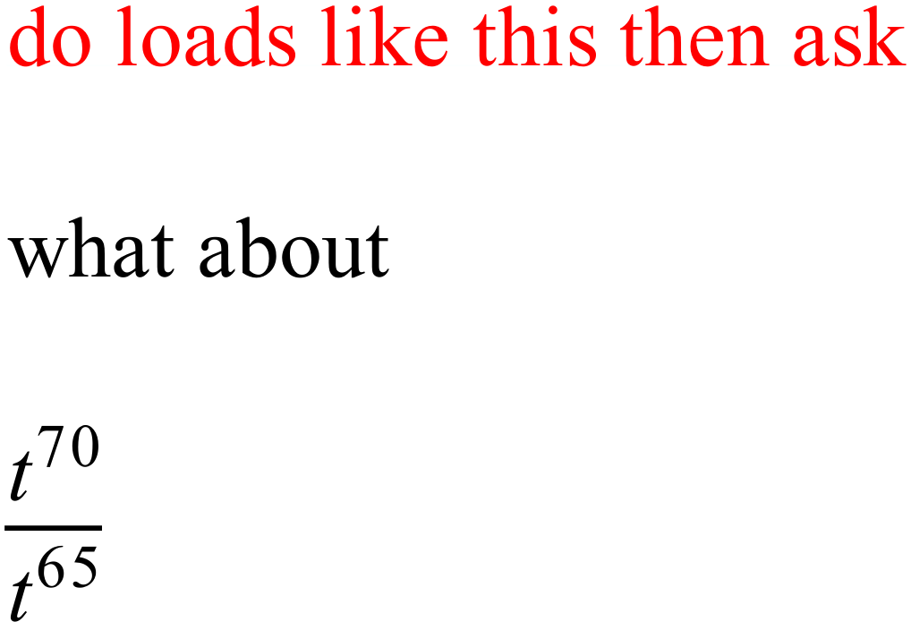

Slide 28
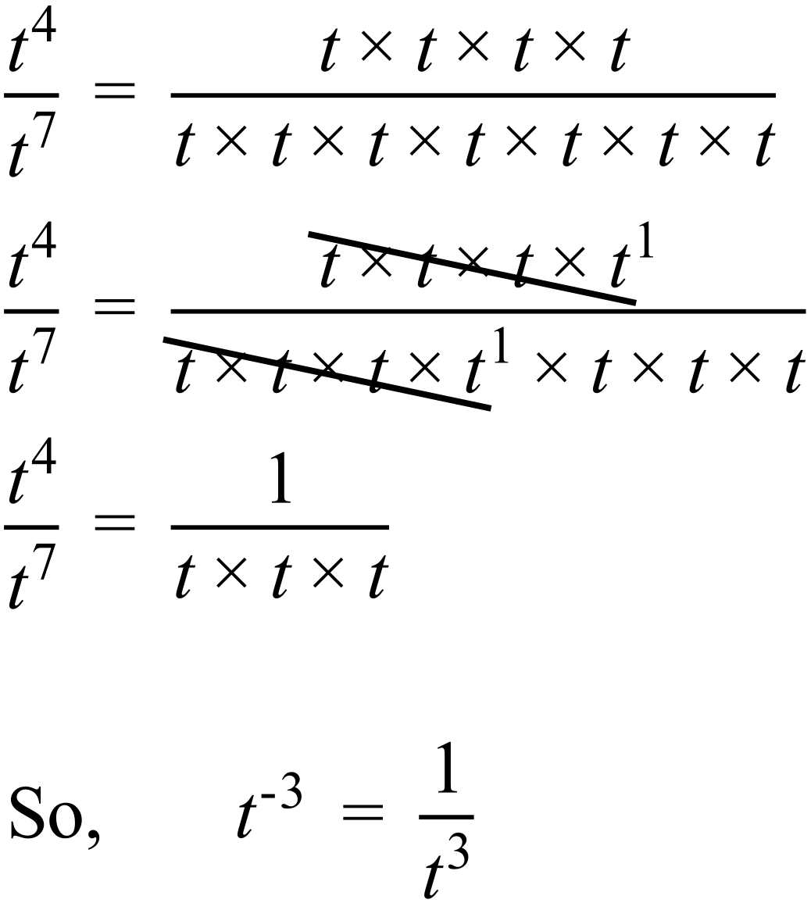
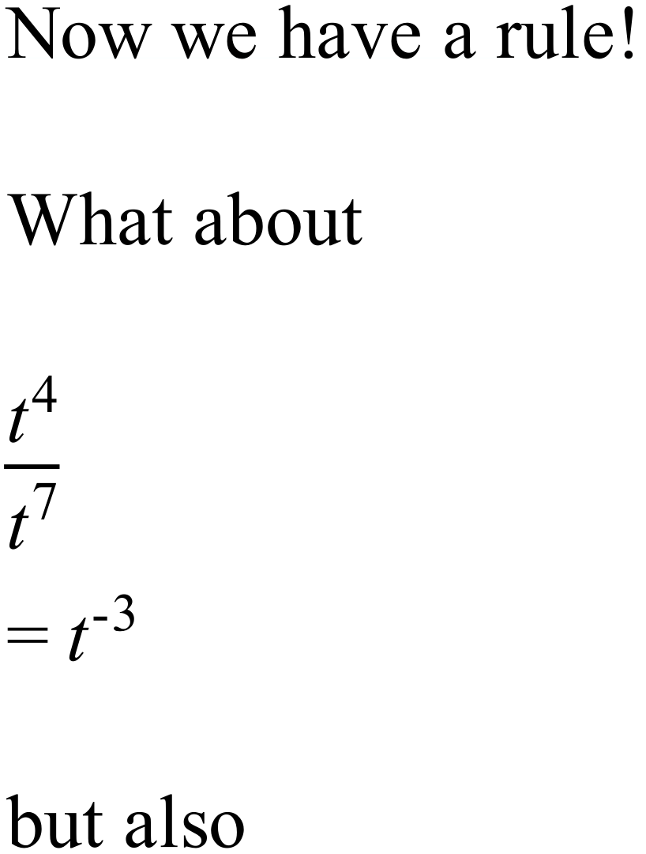

Slide 29
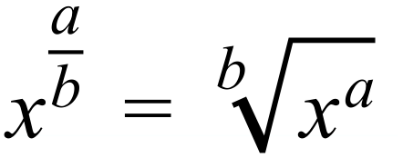
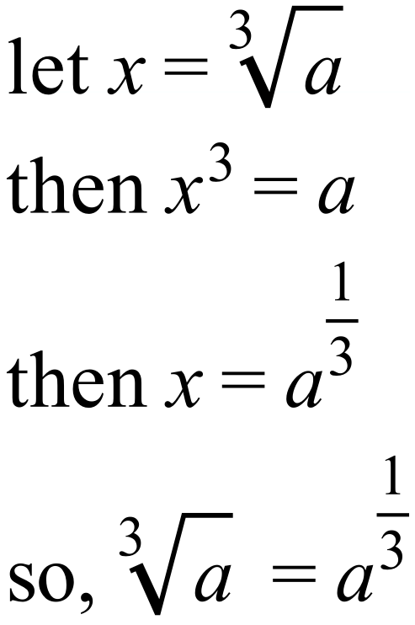
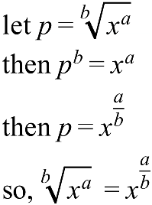
Notes:
Where does this even come from?

Slide 30
Some big ideas in teaching Maths
Wherever possible make connections between topics explicit

Slide 31
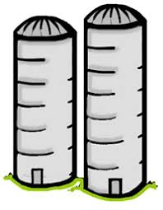
Connect the topics!
percentages – decimals – fractions - ratios

Slide 32
Some big ideas in teaching Maths
Wherever possible make connections between topics explicit
ALWAYS go back to basics

Slide 33
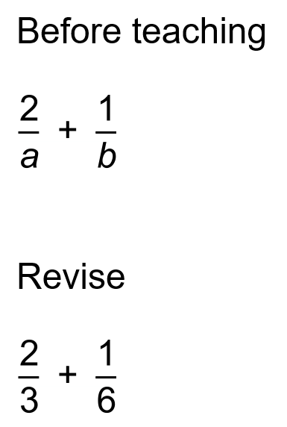
ALWAYS go back to basics!
Notes:
Perhaps this is the first time they understand fractions!
EVERYONE is at a different place

Slide 34
Some big ideas in teaching Maths
Wherever possible make connections between topics explicit
ALWAYS go back to basics
Make connections with the real world
Notes:
Metaphors and connections are helpful!

Slide 35

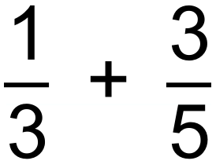
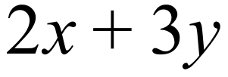
We can only add like things….
Numerator (counts)
1cm and 3mm
Denominator (chooses)
Denominator (chooses)
Numerator (counts)
$1 and R3
Denominator (chooses)
Numerator (counts)

Slide 36
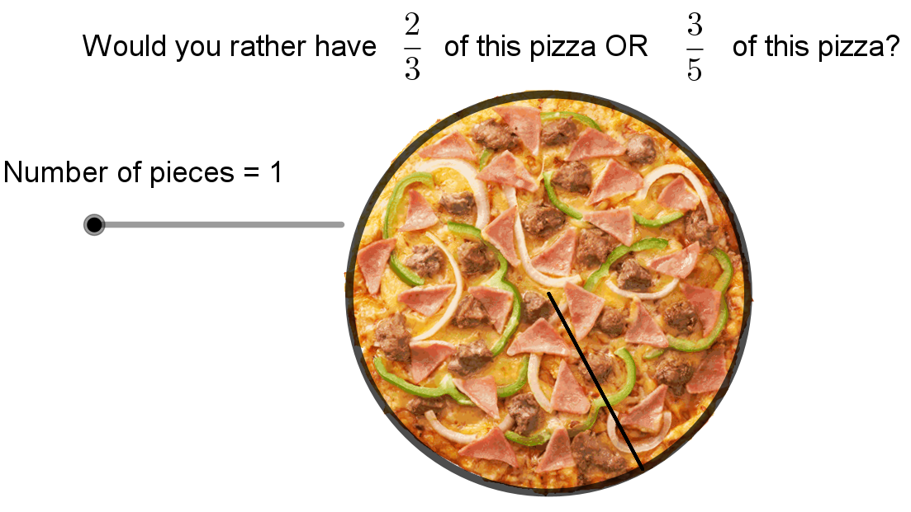
Would you rather have $100 or R1700?

Slide 37
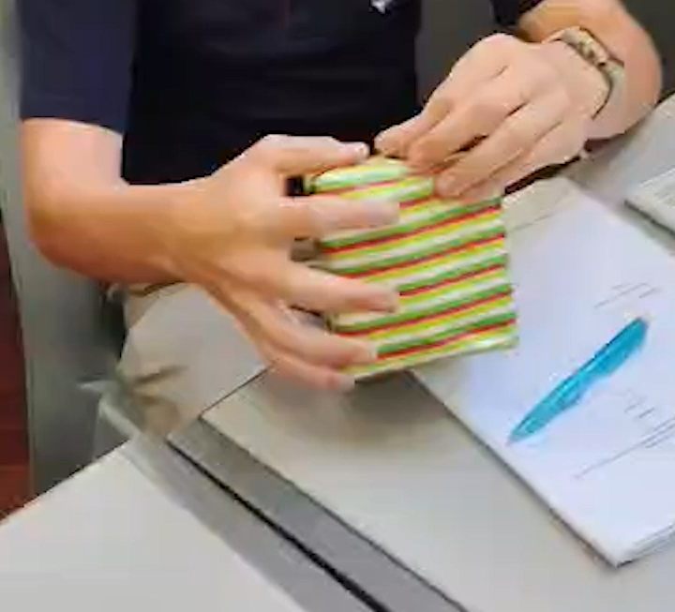

2 real world ideas / metaphors for solving equations…

Slide 38
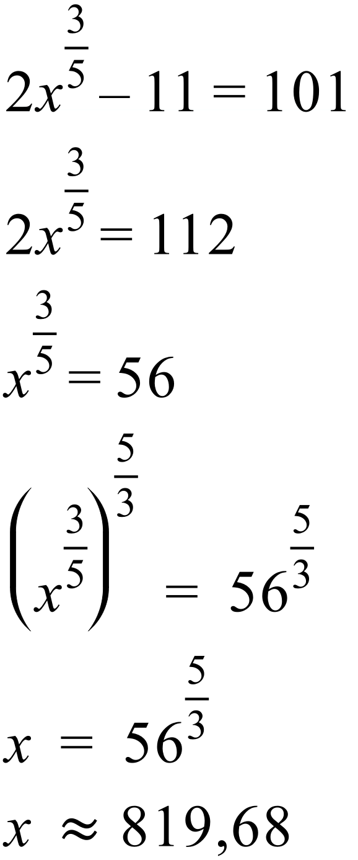

2 real world ideas / metaphors for solving equations…

Slide 39
Some big ideas in teaching Maths
Wherever possible make connections between topics explicit
ALWAYS go back to basics
Make connections with the real world
Mind your language
Notes:
The language we use is all important – I’m not talking about swear words but avoid those anyway!

Slide 40

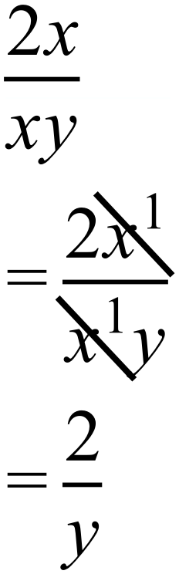

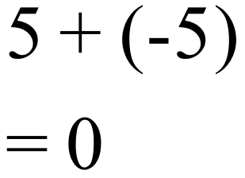
Mind your language….
We are DIVIDING the numerator
and the denominator by x.
We are NOT CANCELLING the xs

Slide 41
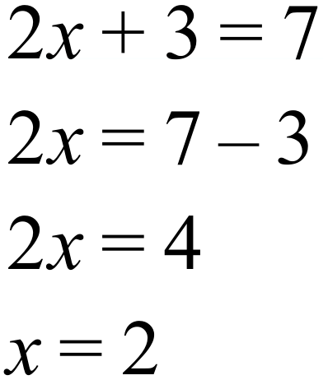
Mind your language….
We are not
TAKING THE 3 TO THE OTHER SIDE AND CHANGING THE SIGN
nor are we
TRANSPOSING THE 3
We are SUBTRACTING 3 FROM BOTH SIDES

Slide 42
Some big ideas in teaching Maths
Wherever possible make connections between topics explicit
ALWAYS go back to basics
Make connections with the real world
Mind your language
Promote collaboration – learning is a social and emotional activity!
Notes:
COLLABORATION is the name of the game – also a life skill
STUDY BUDDY

Slide 43
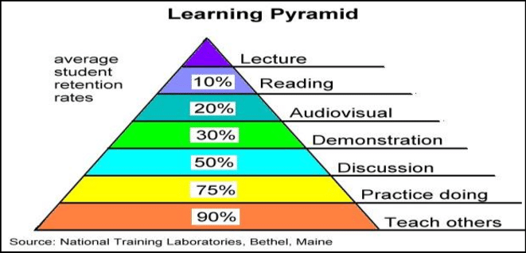

Slide 44
Some big ideas in teaching Maths
Wherever possible make connections between topics explicit
ALWAYS go back to basics
Make connections with the real world
Promote collaboration – learning is a social and emotional activity!
Do LOADS of small, low-stakes assessments
Help bridge the concrete-abstract divide
Notes:
MASSIVE CONSIDERATION! – all at a different place
Wheels fall off at high school……essentially a different subject

Slide 45
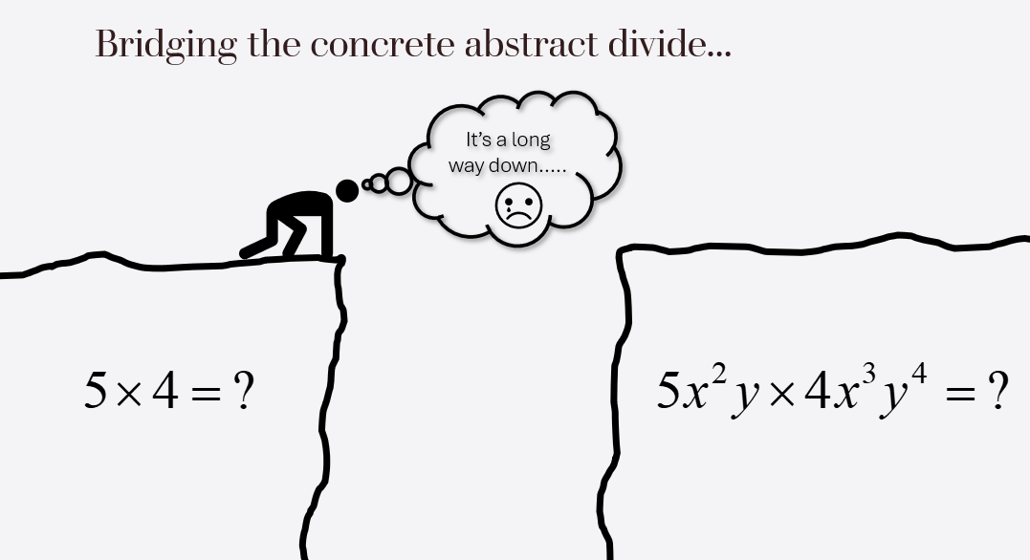
The role of the teacher
Notes:
Cognitive load!

Slide 46
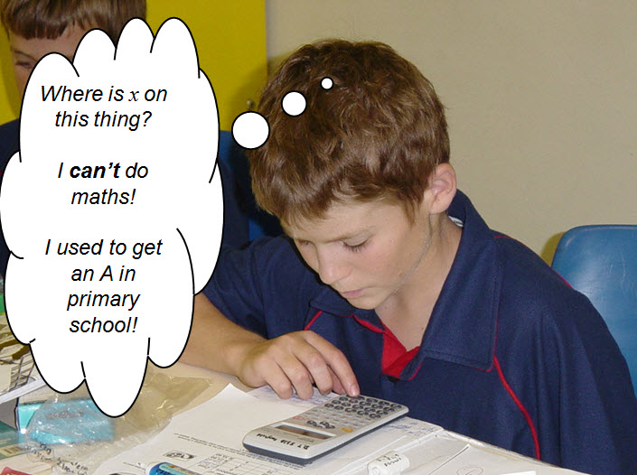

Slide 47
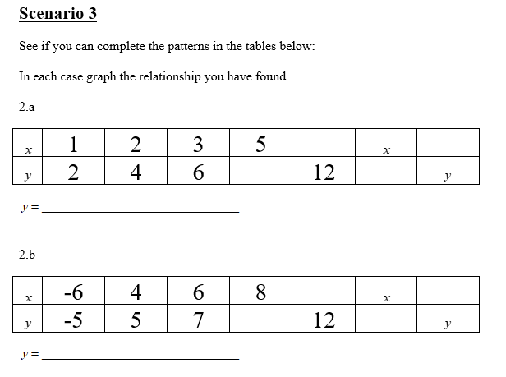

6
10
2x
2x
11
9
2x

Slide 48
Some big ideas in teaching Maths
Wherever possible make connections between topics explicit
ALWAYS go back to basics
Make connections with the real world
Promote collaboration – learning is a social and emotional activity!
Do LOADS of small, low-stakes assessments
Help bridge the concrete-abstract divide
Use technology to help explain things

Slide 49
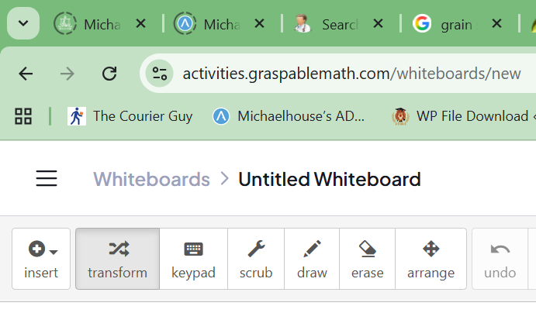
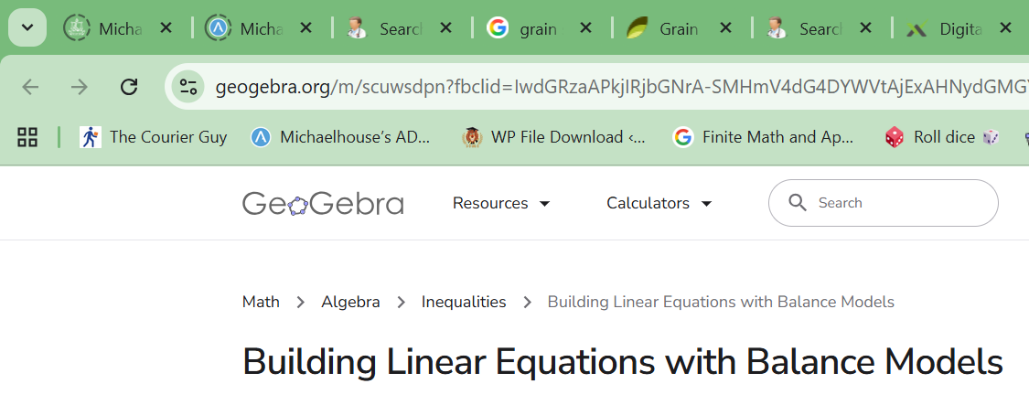
Notes:
GRASPABLES
GEOGEBRA

Slide 50
Some big ideas in teaching Maths
Wherever possible make connections between topics explicit
ALWAYS go back to basics
Make connections with the real world
Promote collaboration – learning is a social and emotional activity!
Do LOADS of small, low-stakes assessments
Help bridge the concrete-abstract divide
Use technology to help explain things
Use manipulatives

Slide 51
“In mathematics education, a manipulative is an object which is designed so that a learner can perceive some mathematical concept by manipulating it, hence its name. The use of manipulatives provides a way for children to learn concepts through developmentally appropriate hands-on experience”. (Wikipedia)

Slide 52
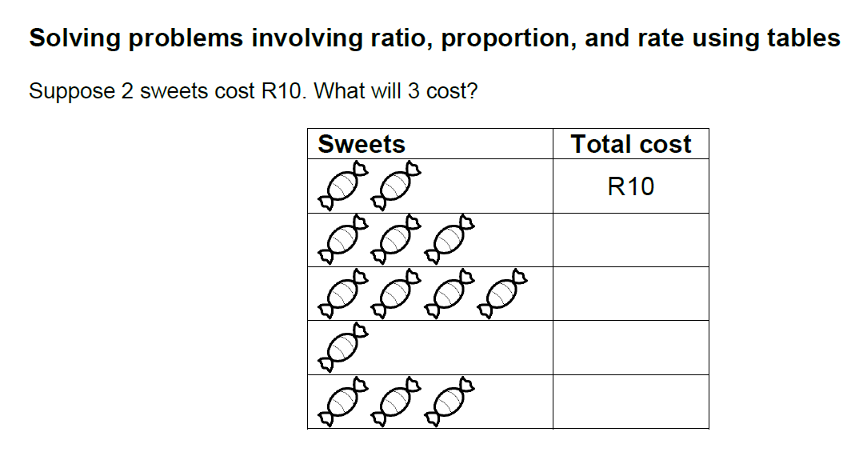

Slide 53
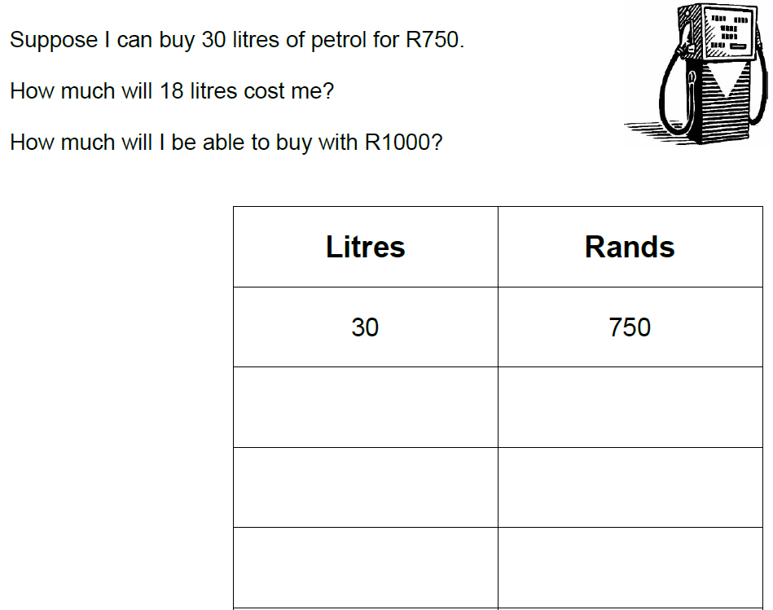

Slide 54
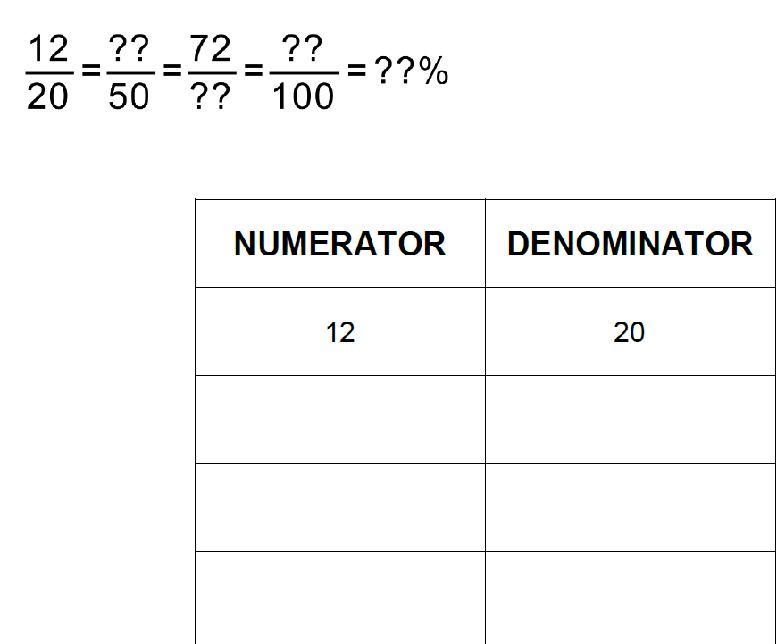

Slide 55
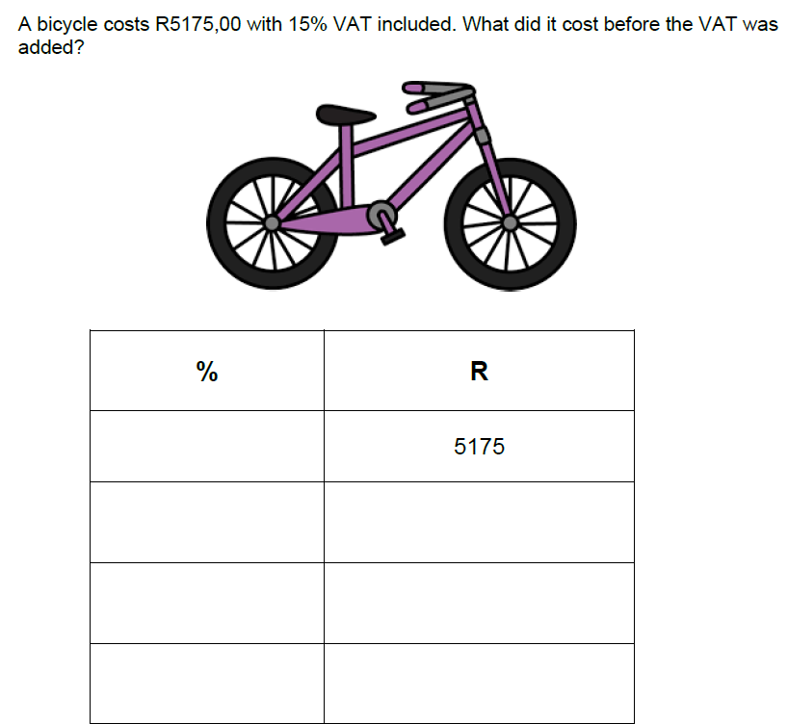

Slide 56
Teaching has nothing to do with the love of power and everything to do with the power of love

Slide 57

It’s easier to grow strong children than to mend broken adults

Slide 58

Look after yourself!

Slide 59



THANK YOU!
simi.education
mathsresources.co.za
Notes:
Q and A
Please follow us on Social Media!
SIMI website for more info. and future events…..
SHOP – ALL proceeds….

