Slide 1

Show me the money!
€
$
The Mathematics of Finance
R
₤
by
Paul de Wet (paul@shayaizibalo.com)

Slide 2


Izibalo zicaceka njalo!
Financial maths
makes cents!
All resources used in this talk will be freely shared on condition that they are freely shared ☺
Shaya Izibalo Maths Institute (SIMI)
www.shayaizibalo.com

Slide 3
% - the SI unit of fractions!
Weather forecasters don’t say “there’s a 37/58 chance of rain tomorrow!”
Decimal | %
0,06
0,6
0,006
1,06
0,94
 | 8%
 | 80%
 | 0,8%
 | 108%
 | 92%
 | 500%
6%
60%
0,6%
106%
94%
0,08
0,8
0,008
1,08
0,92
5

Slide 4










Using a multiplier as an efficient way of increasing or decreasing a number by a given percentage.
Suppose we wish to increase 700 by 6%
Increase 250 by 12%?
This is 106%
This is 112%
What if we wanted to increase 300 by 20%?
Simply multiply by 1,2
Notice that, in each case, our multiplier has been > 1 – we are increasing

Slide 5


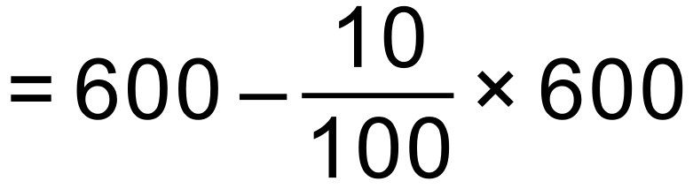

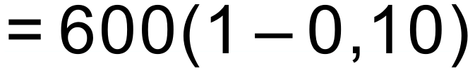

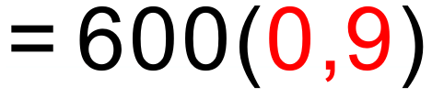
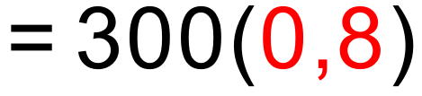


Using a multiplier as an efficient way of increasing or decreasing a number by a given percentage.
What about decreasing 600 by 10%?
Decrease 300 by 20%?
This is 90%
This is 80%
Decrease 90 by 6%
Simply multiply by 0,94
Notice that, in each case, our multiplier has been < 1 – we are decreasing

Slide 6
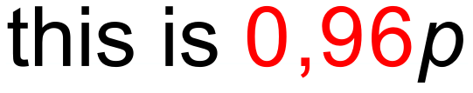
Using multipliers greatly simplifies these types of questions
The price of a share drops by 20% and then increases by 20%. What is the net effect?
A net loss of 4%

Slide 7
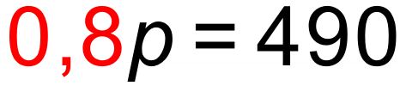
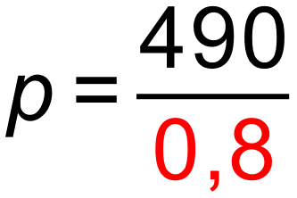

Using multipliers greatly simplifies these types of questions
Suppose an item costs R490 after a 20% discount has been offered. What did it cost before the discount was applied?

Slide 8
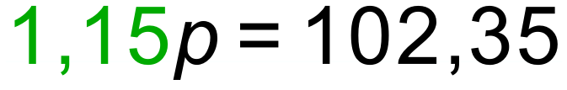
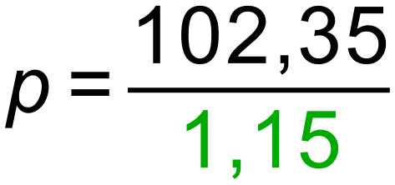
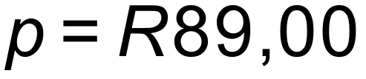
Using multipliers greatly simplifies these types of questions
Suppose an item costs R102,35 with 15% VAT included. What did it cost before the VAT was added?

Slide 9

Using multipliers greatly simplifies these types of questions
The price of a share drops by 10% and then increases by 20%. Would it matter if it increased first and then dropped?

Slide 10
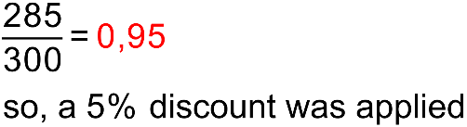
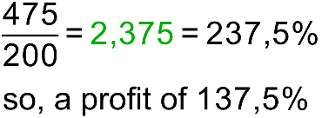
Using multipliers greatly simplifies these types of questions
An item is discounted from R300 to R285. What percentage discount was applied?
An item bought for R200 was sold for R475. What was the percentage profit?

Slide 11
Did you know?
17% of 53
is
53% of 17

Slide 12
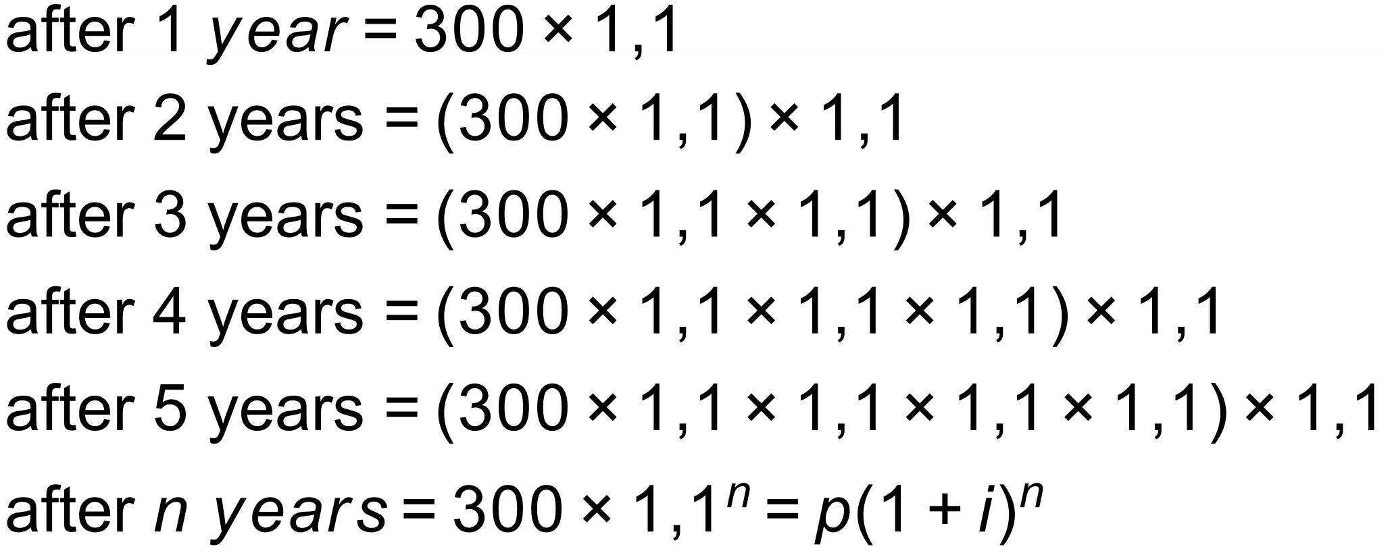
Using multipliers helps us understand the formulae involved
R300 is invested at 10% p.a. compounded annually.
What will it be worth after five years?

Slide 13
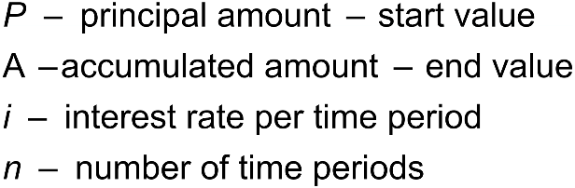






Now let’s review what we learnt before Grade 12
In each of the formulae below:
Appreciation occurs when something GAINS value
 | simple increase / interest
 | compound increase / interest
Inflation is always calculated with the compound increase formula and is always compounded annually.
Depreciation occurs when something LOSES value
 | straight line depreciation
 | reducing balance depreciation
Reducing Balance depreciation is always calculated annually.

Slide 14
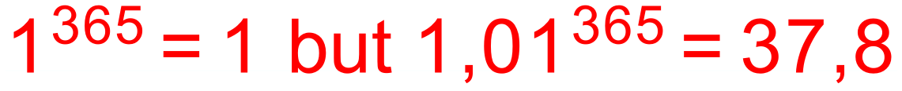
The magical combination of time and compounding
Consider two individuals who start working on the same day. Each works for 30 years. Each invests money into an account paying 12% p.a. compounded monthly.
The miracle of compounding
- just add time!
Ends with: R 1 082 354,01 From an investment of R36 000 | Ends with: R 989 255,37 From an investment of R240 000
IM Clever invests R1000 per month for just the first three years of her career and then leaves the investment in the account.
Miss Doubt waits for 10 years and then invests R1000 per month for the final 20 years of her career.
In a very real sense Miss Doubt missed out!

Slide 15
The rule of 72 – a useful rule of thumb and a cool way to appear intelligent!
If money is compounded continuously at i % p.a. then it will double in value in approximately n years where:
i x n = 72

Slide 16

Nominal and effective rates
12% p.a. compounded quarterly is called a NOMINAL rate.
It can be written in symbols as:
and it means that one will receive 12% interest over the year but one’s interest will be calculated FOUR times per year, 3% each time.
The net result over a year will be GREATER than 12% and is called the EFFECTIVE rate.
Effective rates are always GREATER than nominal rates!

Slide 17
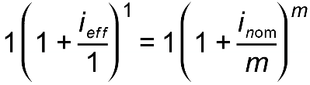
Nominal and effective rates
Some people learn this formula, which is not provided:
However, the easiest way to convert between nominal rates and effective rates is to consider investing R1 for 1 year. The only formula we need is
which is provided.

Slide 18
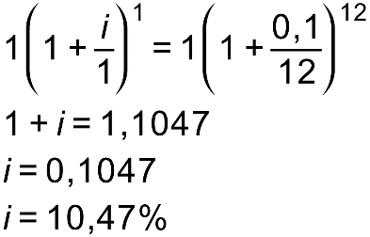
Nominal and effective rates
Convert a rate of 10% p.a. compounded monthly to an effective annual rate
R1 for 1 year!
Effective rates are always GREATER than nominal rates!

Slide 19
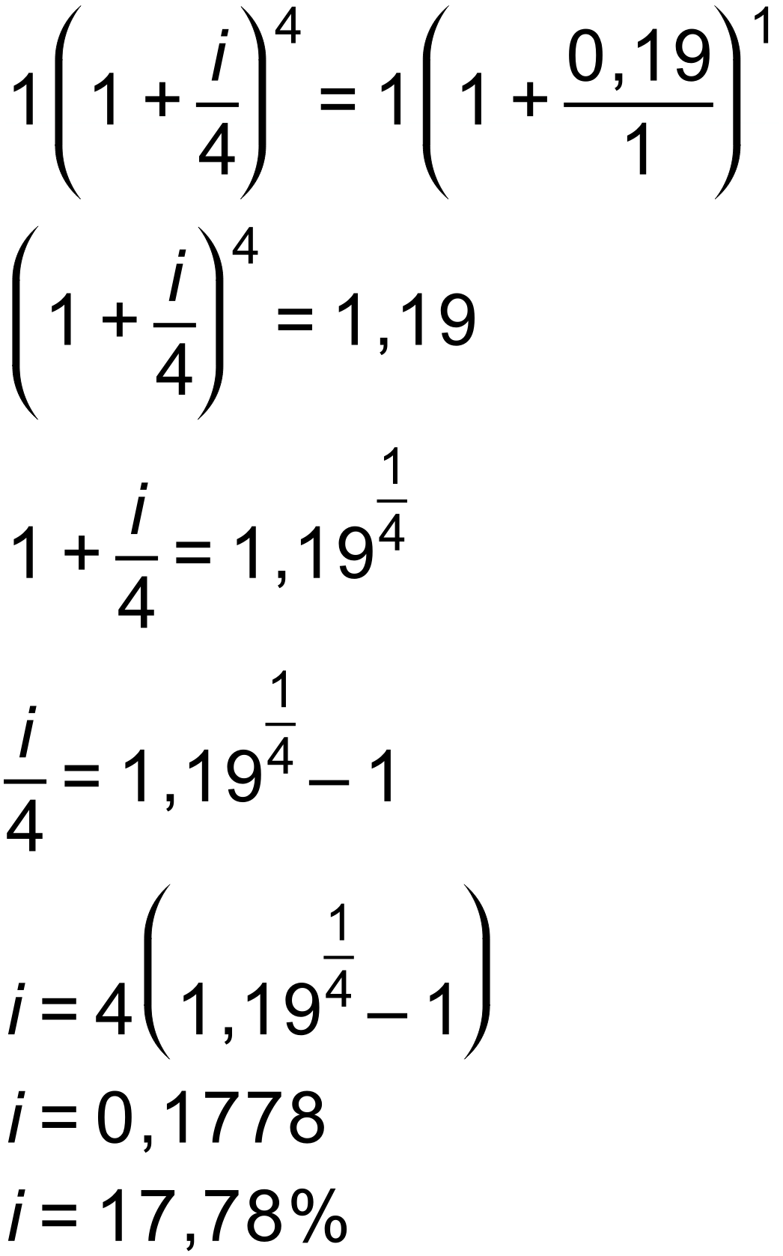
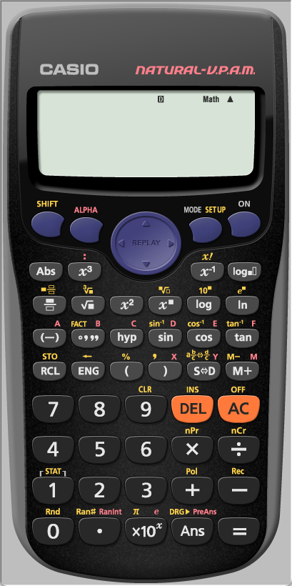
Nominal and effective rates
What annual rate compounded quarterly will give the same return as an effective annual rate of 19%?
R1 for 1 year!
Effective rates are always GREATER than nominal rates!

Slide 20
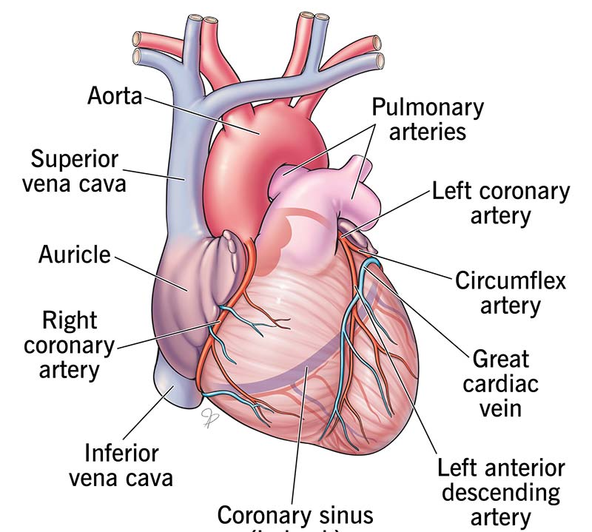
I
accuracy!

Slide 21
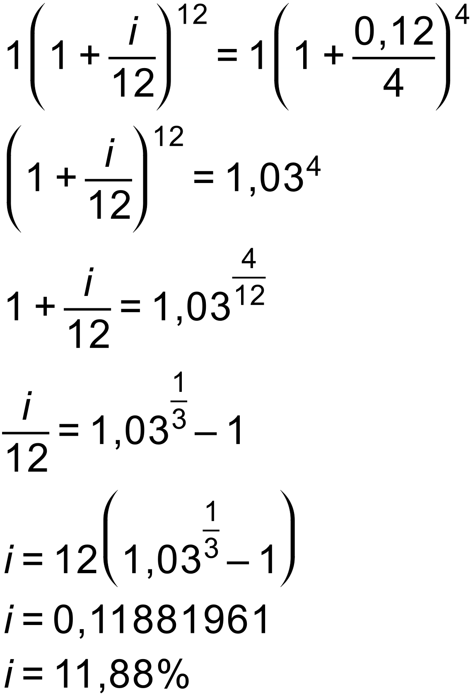

Nominal and effective rates
Determine what annual rate compounded monthly will give the same return as 12% per annum compounded quarterly.
R1 for 1 year!
More frequent compounding compensates for a lower rate!

Slide 22
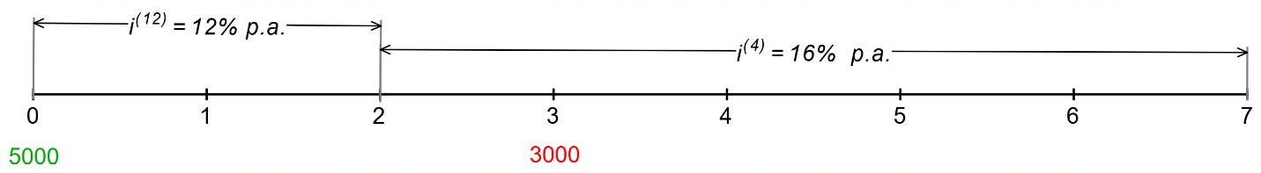
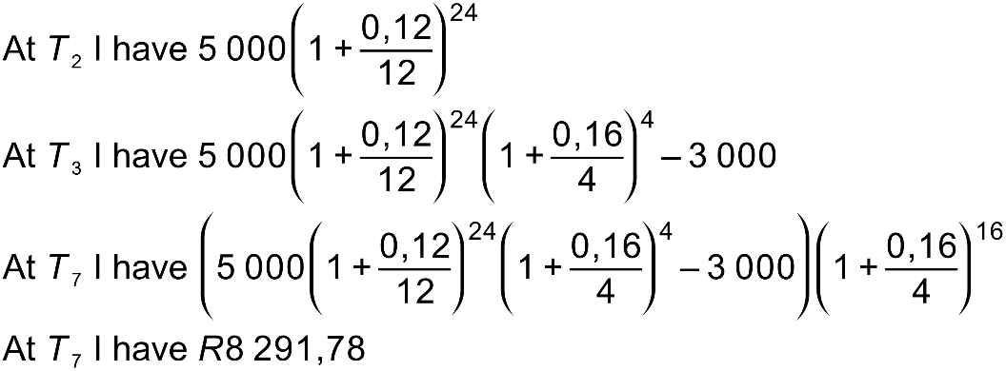
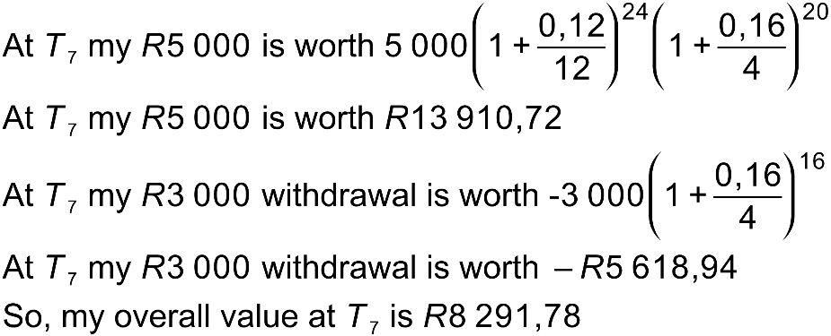
Timelines are useful when there are multiple withdrawals, deposits or changing interest rates.
I deposit R5000. Three years later I withdraw R3000. How much will I have 7 years after my initial deposit if interest is paid at 12% per annum compounded monthly for the first two years and then at 16% per annum compounded quarterly thereafter?
OR consider each “investment” in a separate account

Slide 23
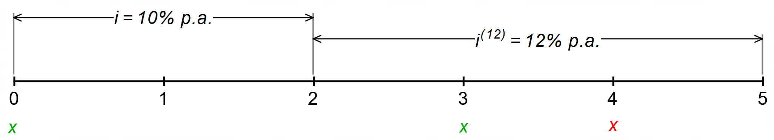
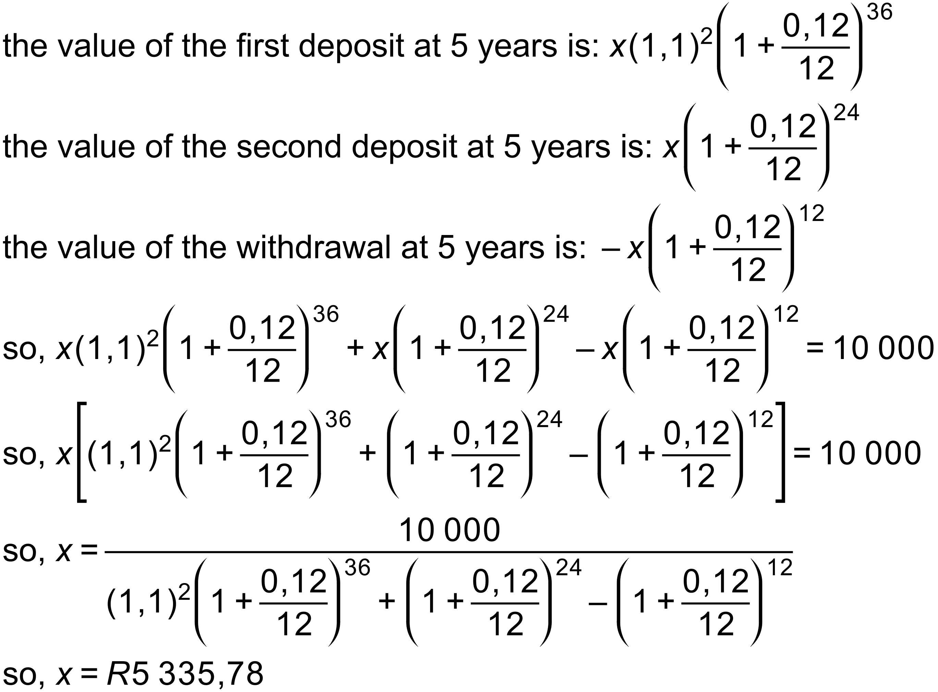
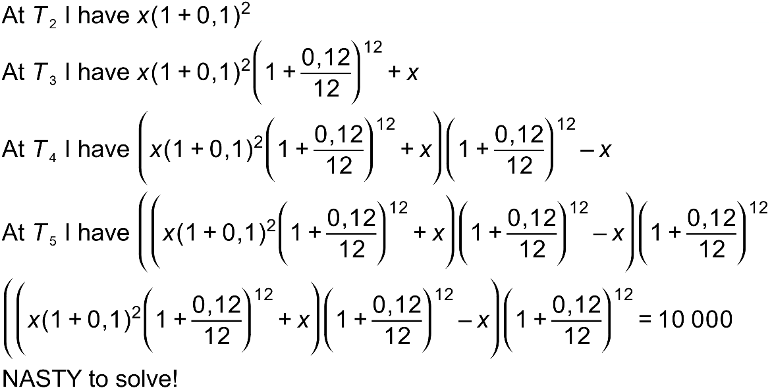
Timelines are useful when there are multiple withdrawals, deposits or changing interest rates.
I deposit an amount of x. Three years later I deposit a further x and then a year after that I withdraw x. Interest is 10% p.a. compounded annually for the first two years and 12% p.a. compounded quarterly for the next three years. Find x if I end up with R10 000 after 5 years.

Slide 24
Annuities
An ANNUITY is a series of equal, regular payments for the purposes of saving (a future value annuity) or
repaying a loan (a present value annuity).

Slide 25
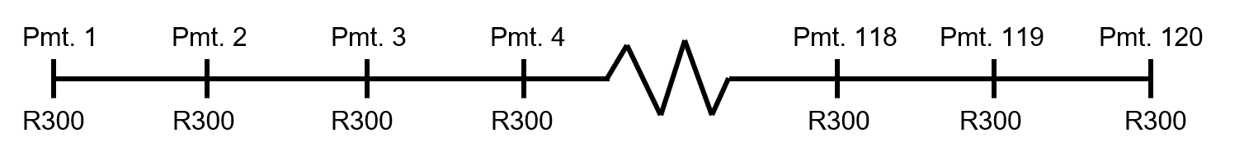


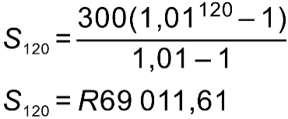
Annuities
Mr Khumalo deposits R300 per month for 10 years into an account which pays interest at 12% per annum compounded monthly.
Note that with annuities, the interest is always compounded with the same frequency as the payments are made.
How much does he have immediately after making his final payment?
Using the formula
and working from the back. Mr Khumalo will have:
This is a geometric series with and n = 120
How much interest did he earn?

Slide 26
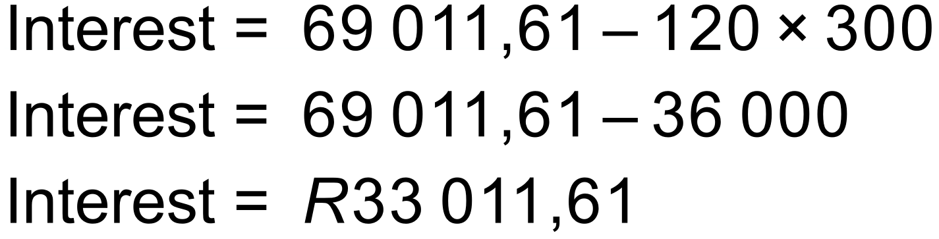
Annuities
How much interest did he earn?
IMPORTANT IDEA!
The interest earned is simply the difference between the total amount and the sum of all the contributions.

Slide 27
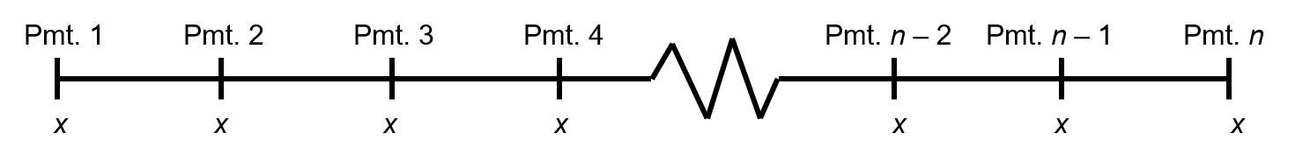
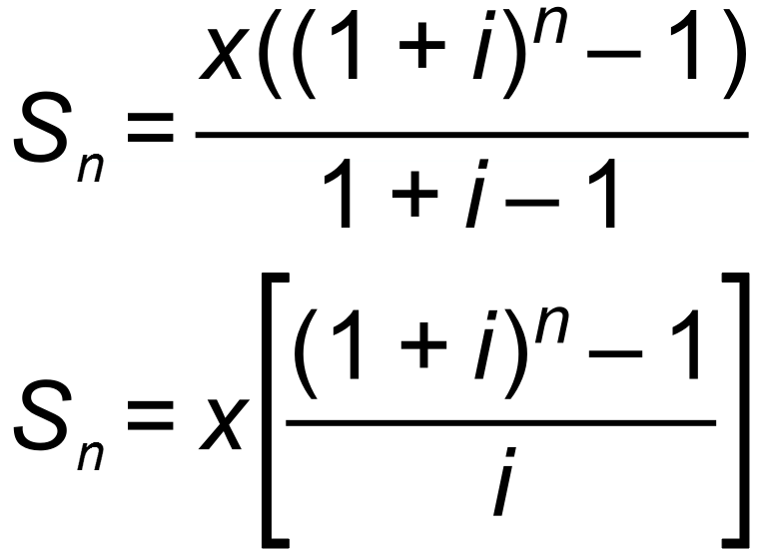
Annuities
Let’s generalize this to create a formula!
Suppose we invest x per interval for n intervals and interest is paid at i% per compounding interval. How much will we have immediately after making our last payment?
Using the formula
and working from the back:

Slide 28
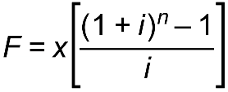
Annuities
Note that this is called the FUTURE VALUE formula. It gives us the FUTURE VALUE of n equal payments of x with interest at i% per compounding period. It gives us the balance immediately after the last payment is made. In other words, the last payment does not earn any interest.
Here it is, as supplied on the formula sheet.

Slide 29
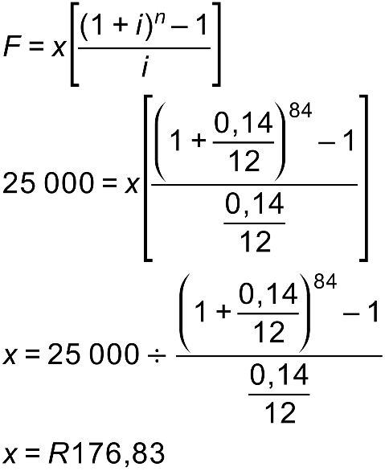
Annuities
I wish to raise R25 000 over a 7-year period making monthly payments. How much must I invest each month if interest is paid at 14% per annum compounded monthly?

Slide 30
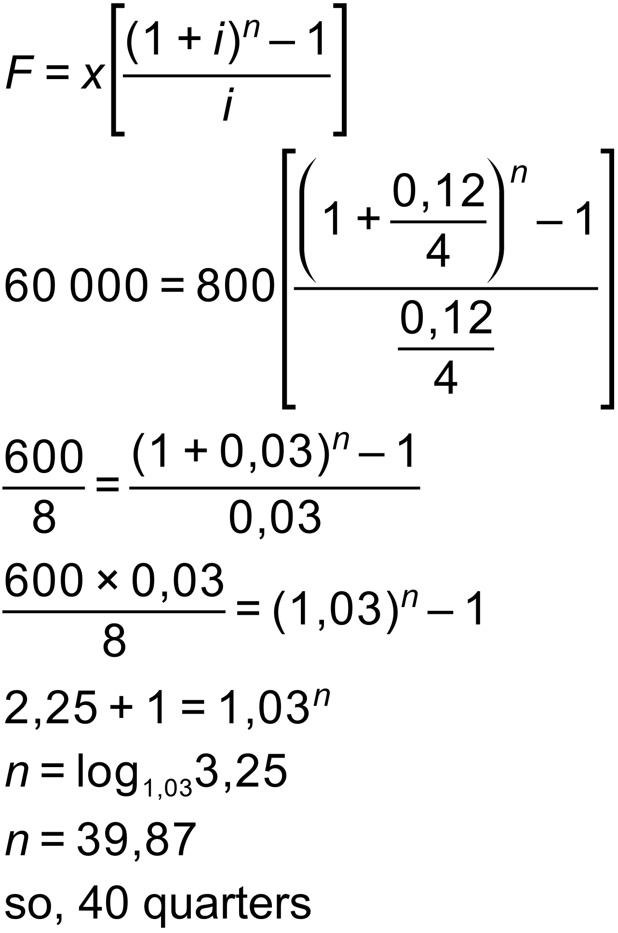
Annuities
How long (to the nearest quarter) will it take me to raise R60 000 if I make quarterly payments of R800 and interest is paid at 12% per annum compounded quarterly?

Slide 31
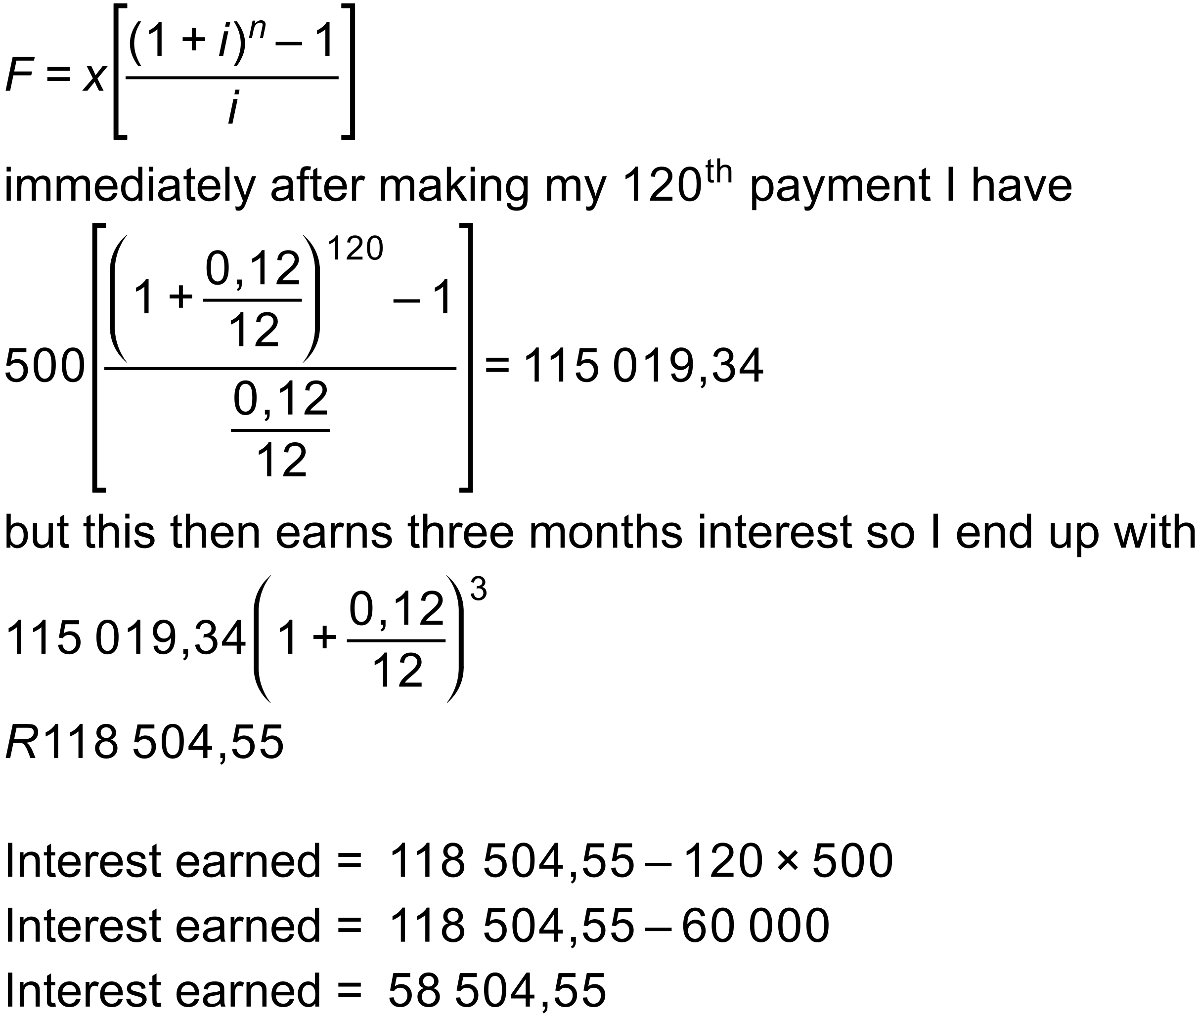
Annuities
I make monthly payments of R500 for 10 years. How much will I have three months after making my last payment if interest is paid at 12% per annum compounded monthly? How much interest do I end up earning?

Slide 32

Do you get a sinking feeling when you see a sinking fund question?
Sinking funds
A sinking fund is a SAVINGS fund which is typically set up for the replacement of equipment.
A sinking fund is typically set up to meet the shortfall between the inflated price of a replacement item and the depreciated value of the item due to be replaced.

Slide 33

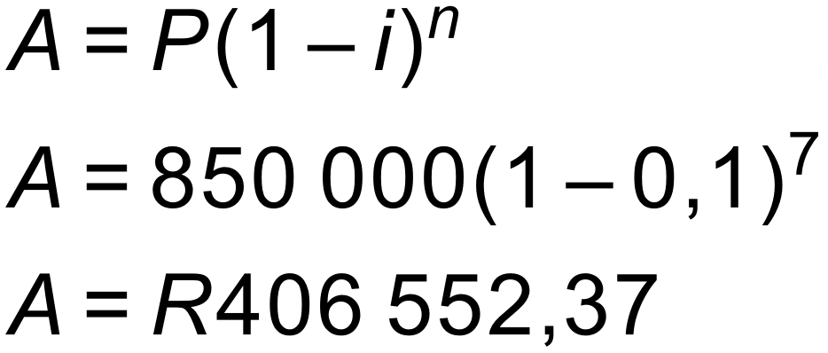
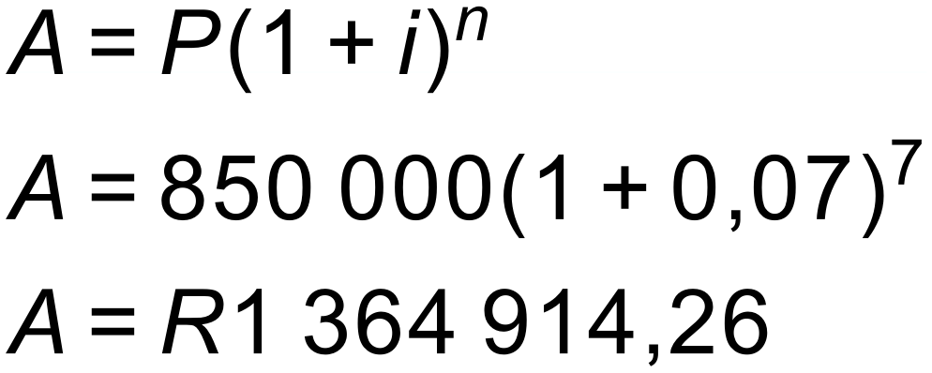
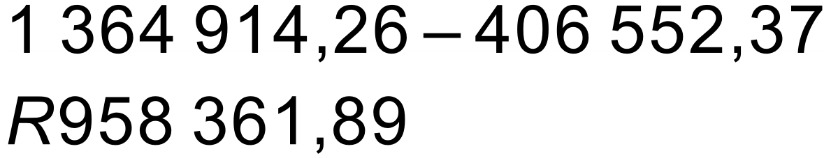
Sinking funds
Skulule’s Construction® has recently bought a TLB (tractor, loader, backhoe) as shown.
It cost R850 000.
Skulule anticipates the following:
It will depreciate at 10% per annum according to the reducing balance method.
He will get 7 years’ worth of use from it after which he will be able to sell it at its depreciated value.
The price of a new TLB is expected to increase due to inflation at an average of 7% p.a.
What will Skulule’s TLB be worth in 7 years’ time?
b) What will a replacement cost in 7 years time?
c) How much money will Skulule be short of replacing his TLB in 7 years’ time?

Slide 34
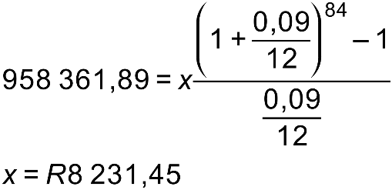
Sinking funds
How much should Skulule’s Construction® put aside each month in a sinking fund in order to be able to replace the TLB. He is able to secure an interest rate of 9% p.a. compounded monthly.

Slide 35

Present value annuities
Before we dive into present value annuities, let’s talk about the time-value of money.
Would you rather have R500 now or in a year’s time?
Definitely NOW!
If I invest it now, I will have more than R500 in a year’s time!
Alternatively, if I spend it on chocolate now, I will get more chocolate now than in a year's time!
The reality is that money has a value which is dependent on when in time it exists. That is why we cannot simply add deposits made at different times on a timeline.

Slide 36







Present value annuities
Suppose I want to borrow some money from you today. I will repay you R100 per year for 5 years, starting one year from now. How much can I borrow if you are going to charge me interest of 12% p.a. compounded annually?
I am going to pay you a total of 5 payments of R100 but each is worth a different amount in today’s terms.
Remember that
is the formula which puts interest onto an amount. So, the formula which removes interest is:
We need to work out the value of each of these future payments in today’s terms
In today’s terms the first payment is worth:
In today’s terms the second payment is only worth:
In today’s terms the third payment is only worth:
In today’s terms the fourth payment is only worth:
In today’s terms the fifth payment is only worth:
The total value of the payments in today’s terms is:
This is how much I can borrow today with these repayment terms.

Slide 37
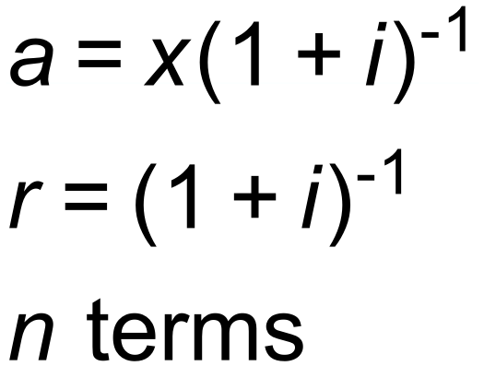
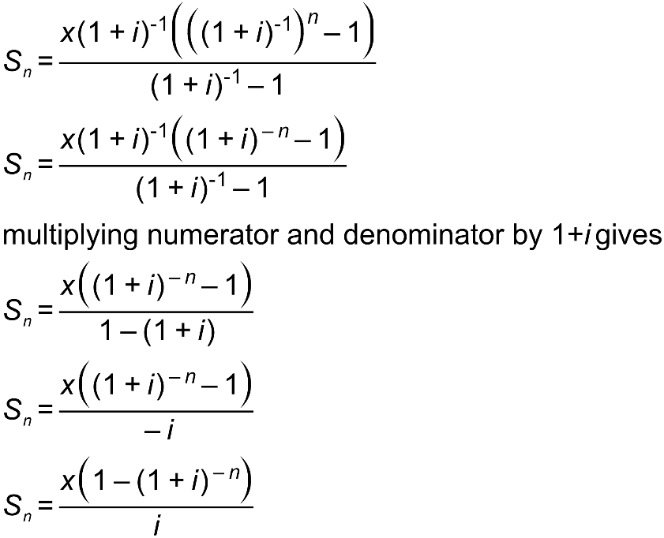
Annuities
Suppose I make n regular payments of x with interest of i% per time period, compounded each time period with my payments starting one period from today. The total value of the payments in today’s terms is:
This is just a geometric series with:

Slide 38
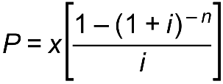
Annuities
Note that this is called the PRESENT VALUE formula. It gives us the PRESENT VALUE of n equal payments of x with interest at i% per compounding period. It assumes that the first payment is made one payment period from today.
Here it is, as supplied on the formula sheet.

Slide 39
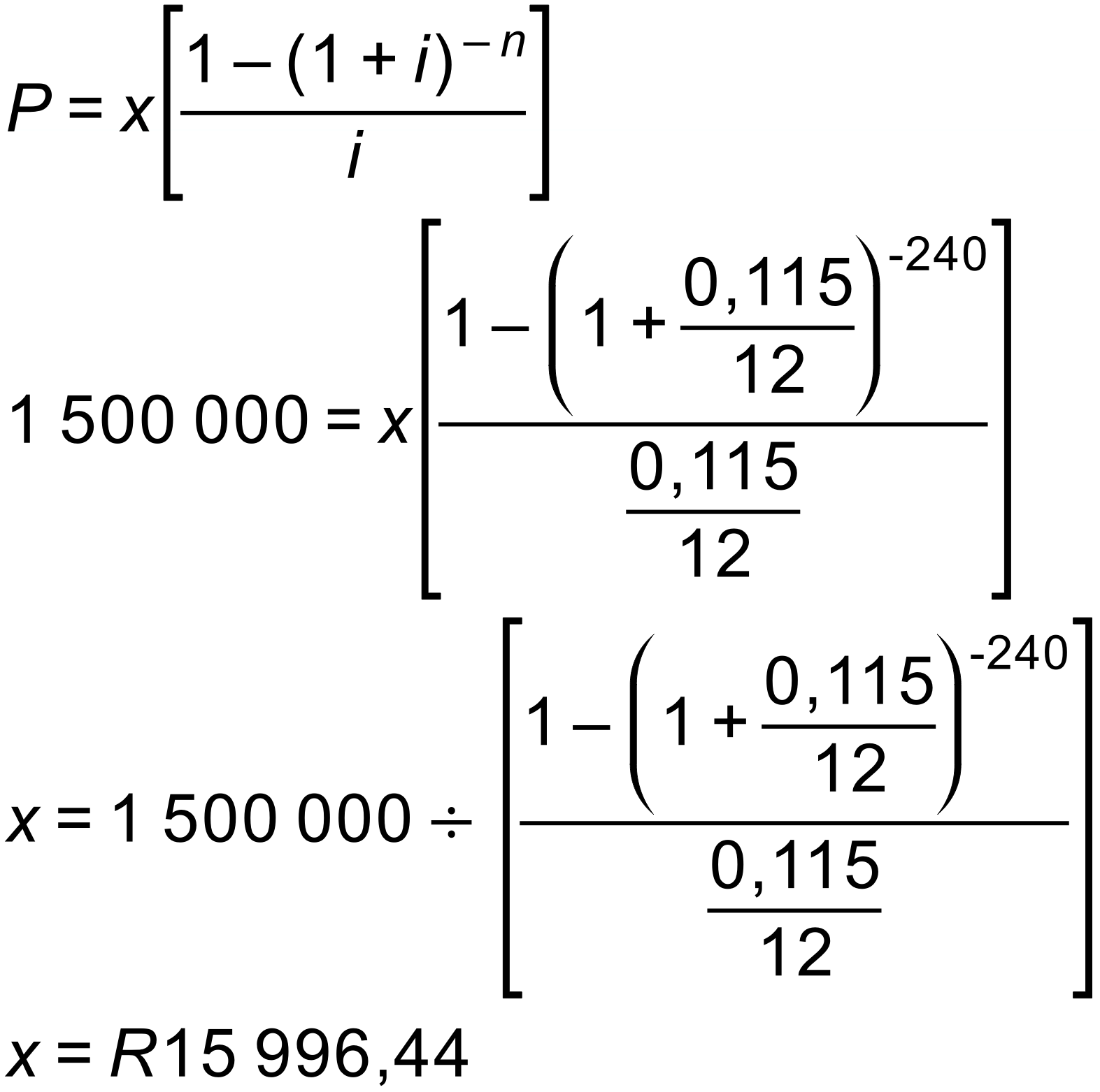

Annuities
Mr Ngcobo borrows R1 500 000 from ABSA to buy a house and agrees to pay it back over 20 years with equal monthly payments starting one month from the date of the loan. Interest is charged at 11,5% per annum compounded monthly. How much is his monthly payment?
How much interest does he end up paying?

Slide 40
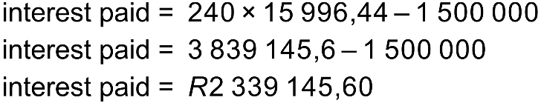

Annuities
How much interest does he end up paying?
An important idea:
The total interest paid is the difference between the sum of all the payments and the amount borrowed.

Slide 41
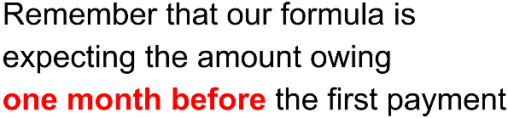
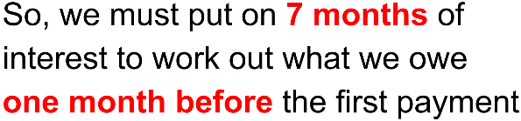

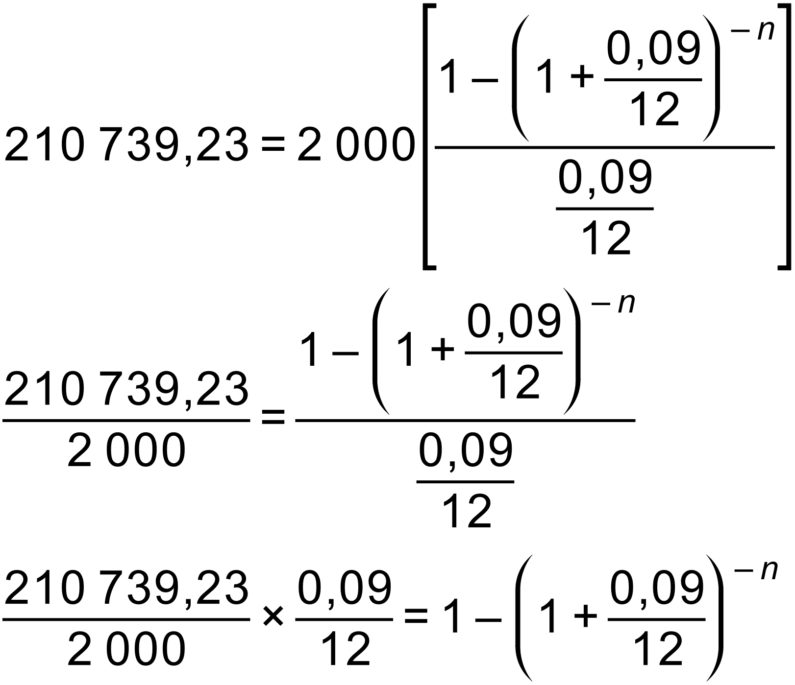
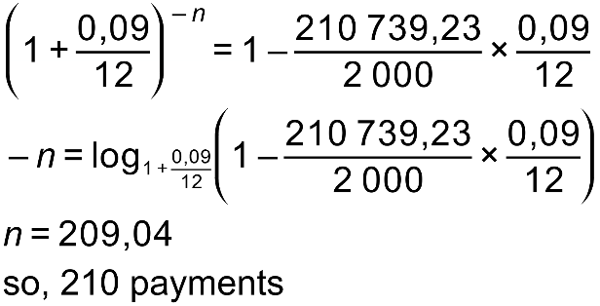
Annuities – deferred annuity – a delay before starting payments
Why wait?
I borrow R200 000 and repay it with monthly payments of R2000 starting 8 months from the date of the loan. If interest is at 9% per annum compounded monthly, then how many payments must I make. Give the total number of payments even though the last one will be less than R2000.

Slide 42
Annuities – an aMORTization schedule
Suppose I borrow R20 000 with interest charged at 15% per annum compounded annually. I repay it over 4 years.
Complete the following Amortisation Schedule. First, we need to work out the monthly payment.
It is R7 005,31
Pmt No. | Interest charged | Outstanding balance immediately before this payment | Annual payment | Proportion of payment going to interest. | Proportion of payment going to capital. | Outstanding balance immediately after this payment.
1
2
3
4

Slide 43
Annuities
When a loan is repaid, each payment pays the interest charged on the outstanding balance after the previous payment has been made.
So, for example, after the 6th payment is made there is still an amount owing. One month of interest is then added to this amount. The 7th payment then pays this interest while also reducing the value of the loan (capital)
Any payment is split between paying capital and paying interest. The interest is always calculated on the amount still owing so, while the payment stays the same, the proportion of the payment going to interest gradually reduces while the complement (the balance) increases – this is the proportion going to reducing capital.

Slide 44
Annuities

Slide 45
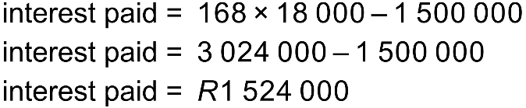

Annuities
How to save nearly a million rand!
By paying in extra on a bond we reduce the total interest charged as the extra contribution goes directly to reducing the CAPITAL (the amount owing)
Consider the previous home loan example
R1 500 000 repaid over 20 years @ R15 996,14 per month
When the exact minimum monthly payment of R15 996,44 was made we had:
However, if we increase our monthly payment to R18 000 then we only need 168 payments and now

Slide 46
Annuities
We can calculate how a given payment (or a range of payments) is split between interest and capital. Before we can do this, we need to be able to calculate the OUTSTANDING BALANCE at any given stage of a loan. This is the amount that is outstanding at any given time.

Slide 47
Annuities – outstanding balance (OB)
There are two ways of working out an outstanding balance.
EITHER
Method 1
Calculate the value of the loan plus interest less the value of all the payments that have been made plus interest (a future value annuity). This makes sense!
OR
Method 2
Calculate the present value of all the outstanding payments (those that have not been made). This too makes sense!
Unfortunately, METHOD 2, while simpler, only works when we know the total number of payments and the required payment is being met exactly.
If extra is being paid or if we don’t know the number of payments up front we must use method 1. Method 1 always works, and it is therefore favoured by most teachers.

Slide 48


Annuities – outstanding balance
Hlengiwe borrows R100 000 in order to buy a car. She repays it with equal monthly payments over 5 years, starting one month from the date of the loan. Interest is charged at 12% p.a. compounded monthly. We can show that her monthly repayment is R2 2244,44.
How much does Hlengiwe owe immediately after making her 25th payment?
METHOD 1
Calculate the value of the loan plus interest less the value of all the payments that have been made plus interest (a future value annuity)
METHOD 2
Calculate the present value of all the outstanding payments (those that have not been made) – in this case 35)
Note: these will only work out to be identical if the exact, unrounded value is used for the payment

Slide 49

Annuities – outstanding balance
Cindy borrows R100 000 in order to buy a car. She repays it with monthly payments of R3 000 starting one month from the date of the loan. Interest is charged at 12% p.a. compounded monthly.
How much does she owe immediately after making her 20th payment?
METHOD 2 will not work!
METHOD 1
Calculate the value of the loan plus interest less the value of all the payments that have been made plus interest (a future value annuity)

Slide 50



Annuities – calculating CAPITAL vs INTEREST split for a single payment
When a loan is repaid, each payment pays the interest charged on the outstanding balance after the previous payment was made.
Busi borrows R30 000 and repays it over 4 years with monthly payments starting one month from the date of the loan. Interest is charged at 18% p.a. compounded monthly.
Calculate her monthly repayment
b) Calculate how her 36th payment is split between interest and capital. Can we use method 2?
Now, after making her 35th payment the bank charges one month of interest.

Slide 51

Annuities – calculating CAPITAL vs INTEREST split for a range of payments
Suppose we know the outstanding balance at two points in time – let’s call them OB1 and OB2
The difference between them OB₁ – OB₂ is CAPITAL
We can work it out as a percentage of the total of all the repayments made between these times.
think of the extreme end points of a loan ☺
This will be the percentage of those payments which went to CAPITAL
The complement (balance of 100%) will be the percentage of those payments which went to INTEREST

Slide 52



Annuities – calculating CAPITAL vs INTEREST split for a range of payments
Kabelo borrows R200 000 from the bank. He repays it with quarterly repayments over 5 years, making his first payment one quarter from the date of the loan. Interest at 12% per annum compounded quarterly.
What percentage of his payments in the second year goes to capital? To interest?

Slide 53
Annuities – calculating a last, lesser payment
Often when people repay a loan, they work out what they can afford to pay. This then results in a non-whole number of payments. We have already encountered this, but we sidestepped it by simply rounding our answer to the nearest month.
As mathematicians we love accuracy so let’s look at calculating the last, lesser payment.

Slide 54

Annuities – calculating a last, lesser payment
Sihle borrows R40 000 with interest charged at 9% per annum compounded monthly. He repays R900 per month starting one month from the date of the loan.
How many payments does he make?
So, he makes 54 payments of R900 and one last, lesser payment.
Note:
We cannot work out the final payment by calculating
0,26 of a payment. We would get R238,04

Slide 55


Annuities – calculating a last, lesser payment
Method 1
Method 2
Remember that the present value of all of the payments must equal the value of the loan. Let’s let the last payment be x
Remember
Calculate the outstanding balance after 54
payments and add one month of interest!
Which method?

Slide 56

SUMMARY
We have two types of annuity:
Future Value | Present Value
For saving / investing | For repaying a debt
The formula gives the future value of all the payments immediately after the last payment has been made | The formula gives the present value of all the payments given that the first payment is made in one period from now
With both, the payments are made in the future but with a future value annuity, we are interested in the value of the payments in the future. Such annuities apply to savings. With a present value annuity, which is used for loans we are interested in the value of the payments today as that is when we are borrowing the money.
It is vital to remember out what each formula gives us:

Slide 57

A final question…
A man invests R5000 per month for 25 years into an account paying 10% p.a. compounded monthly. Thereafter he retires. If he plans to live for 15 years. How much can he withdraw each month if his money now earns interest at 8% p.a. compounded monthly? You can assume he wishes to die penniless!
Future value or present value?
BOTH!

Slide 58

A final, final question…
A lady buys a house costing R2 000 000. She takes a bond over 20 years and makes monthly repayments starting one month from the date of the loan. Interest is charged at 11% p.a. compounded monthly. After 5 years she decides to put in a swimming pool costing R170 000 and she borrows this money from the bank without extending the duration of the loan. How much extra does she need to pay per month to enjoy her pool?
Calculate the monthly payment
Work out the outstanding balance after 60 months
Add R170 000
Work out the monthly payment on a new loan over 180 months
Find the difference between the two payments

Slide 59
A final, final consideration…
The dilemma of compound interest
Suppose my money is being compounded annually. If I visit the bank after 364 days, I will receive no interest. This hardly seems fair ☹.
We know that compounding more often is more beneficial. So, what do banks do?
Consider R1 invested for 1 year at 100% interest but with different compounding periods:
Compounded | Final amount
annually | R2,000000000
semi-annually | R2,250000000
monthly | R2,613035290
weekly | R2,692596954
daily | R2,714567482
hourly | R2,718126692
every minute | R2,718279243
every second | R2,718281781
every millisecond | R2,718277881
The amount approaches a limit of e – like pi, it is a famous irrational constant.

Slide 60


A final, final consideration…
The formula for continuous compound increase is
So, for example, if R1000 is invested for 6 years at 12% p.a. compounded continuously
We end up with
The rule of 72!

Slide 61
Conclusion
Word your questions fairly
Thanks for listening
Teach your student not only about the value of money but also teach them the values of:
  Decency
  Kindness
  honesty

Slide 62
  Teaching has nothing to do with the love of power but everything to do with the power of love.

Slide 63
?
?
?

